Slide 1
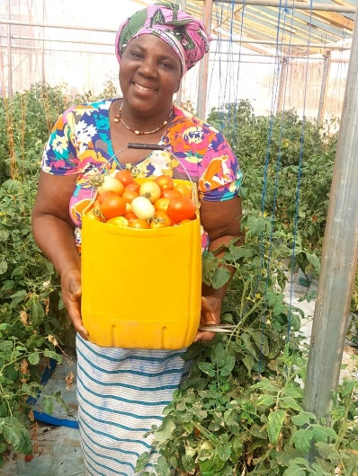
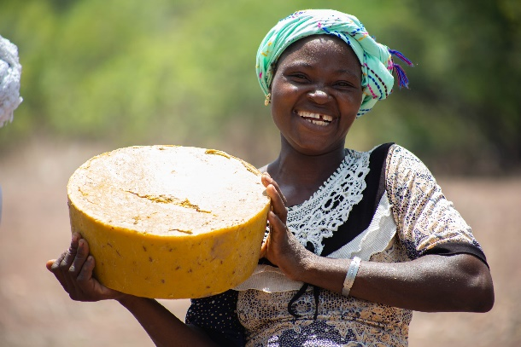
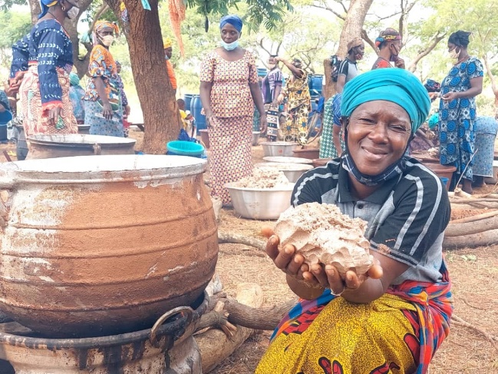
PNCE-B and Shared Interest Foundation
Recognition of shared Interest aims, objectives and mission
SIF and PNCE-B share the same aims
Partnership officially started in 2018 with launch of our Bees for Business project
Together delivered seven projects supporting 405 economically vulnerable women to develop sustainable enterprises and increase their income

Slide 2
BEES FOR BUSINESS

Slide 3
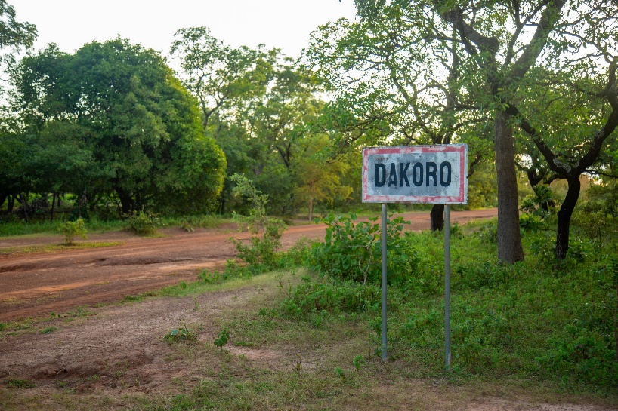
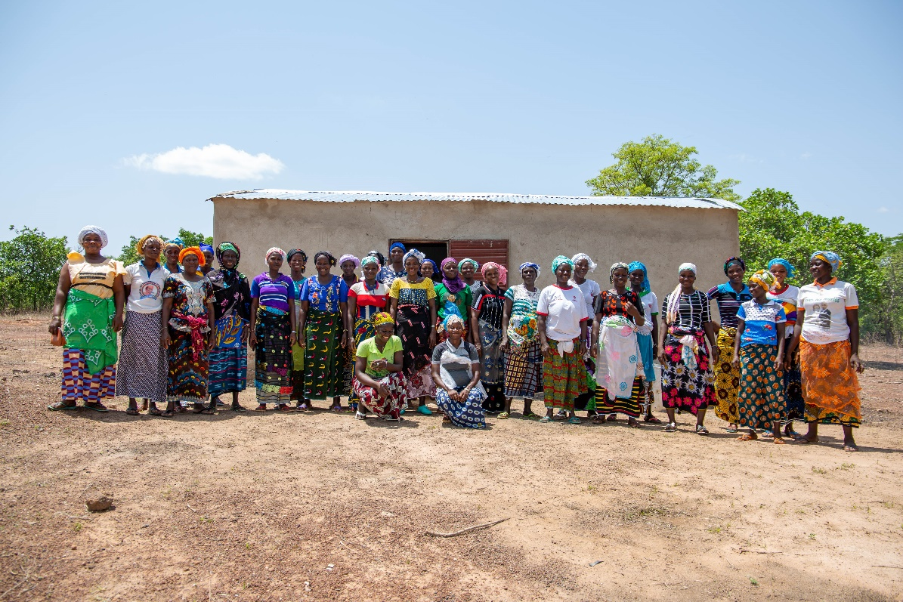
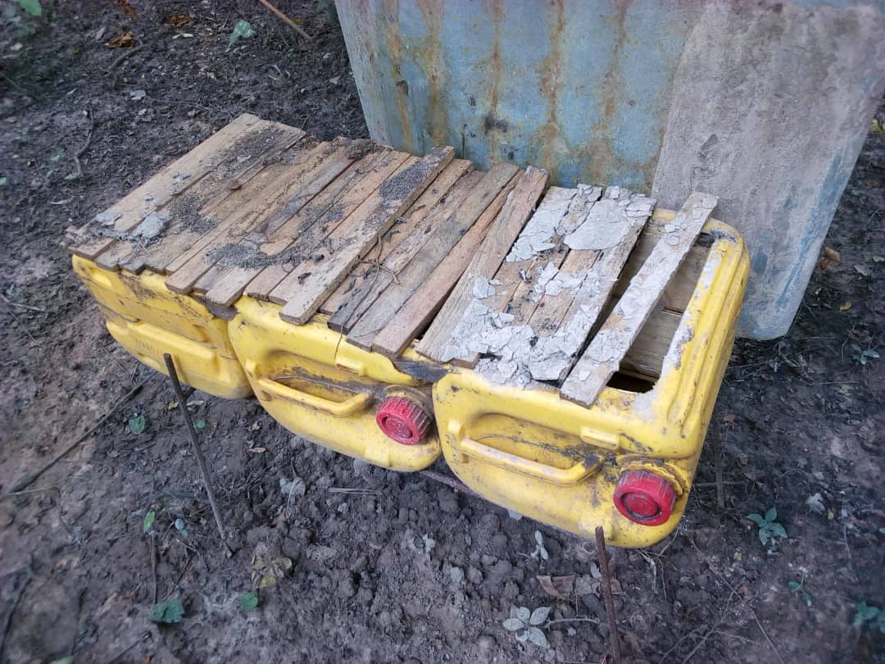
Bees for Business
(Dakoro and Sidéradougou) 2018 - 2021

Slide 4
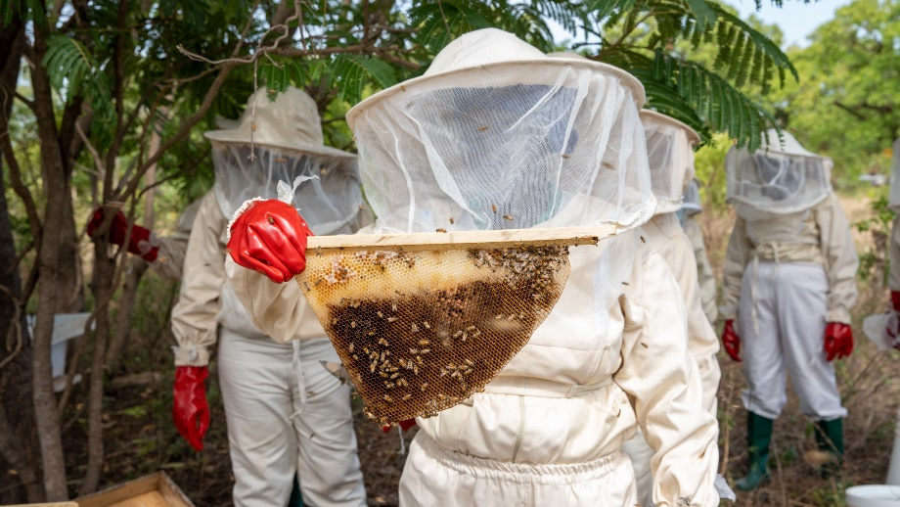
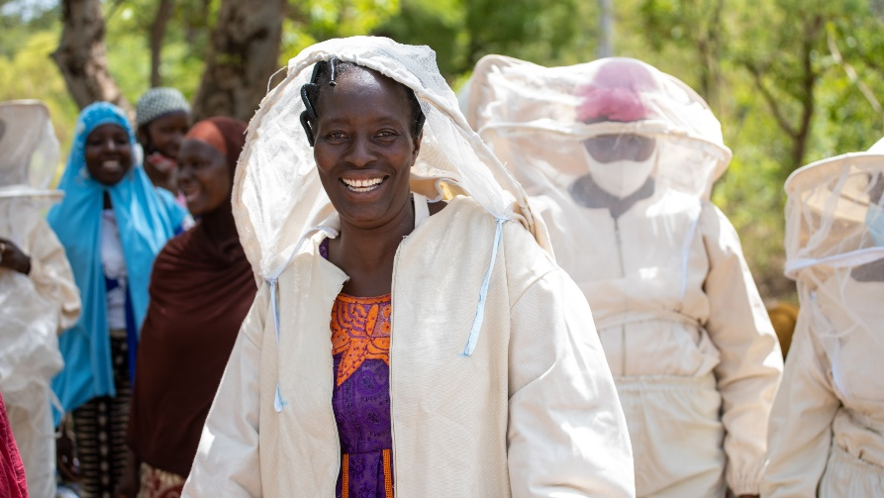
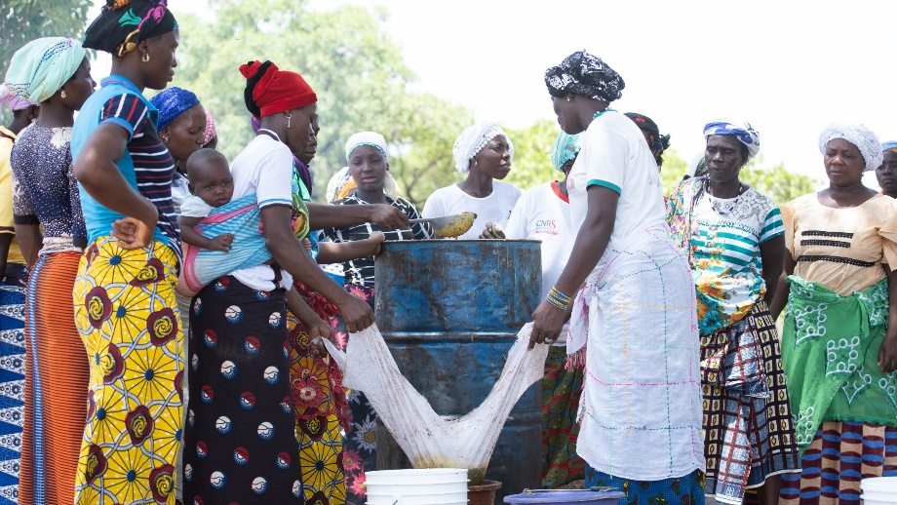
Bees for Business
(Dakoro and Sidéradougou)
125 women trained
Two beekeeping enterprises established (Benkadi à Dakoro and AAS à Sidéradougou)

Slide 5
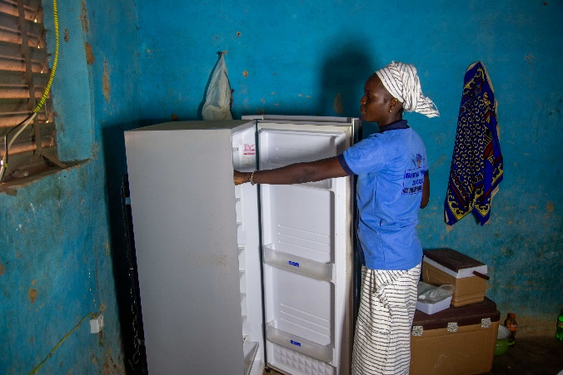
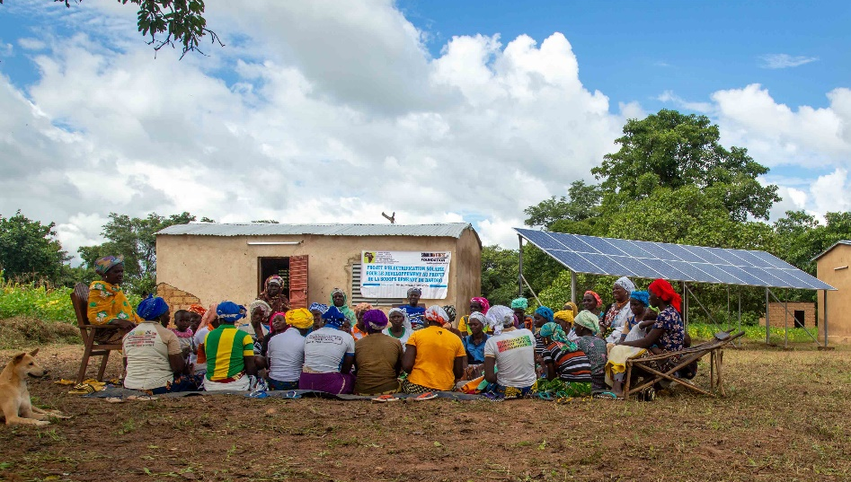
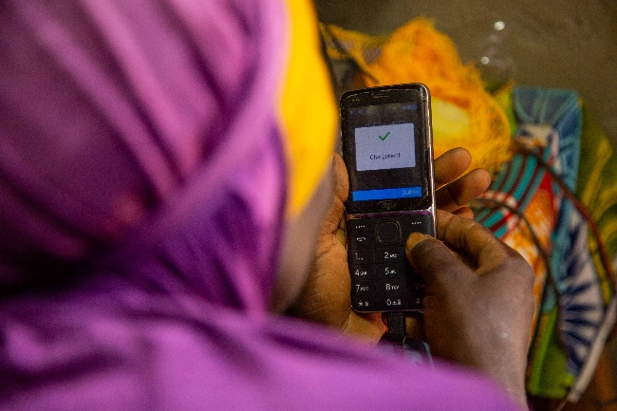
Improving business through the installation of a solar panel at Dakoro (2022)
Installation of fans and lighting in the honey processing warehouse
Establishment of juice enterprise
Connecting over 20 households to electricity for the first time

Slide 6
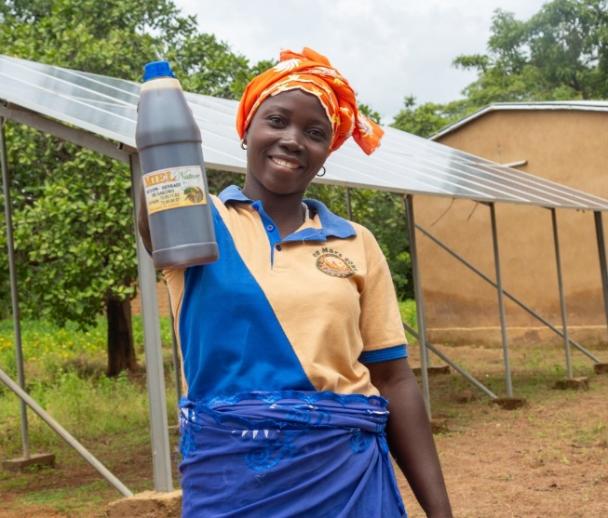
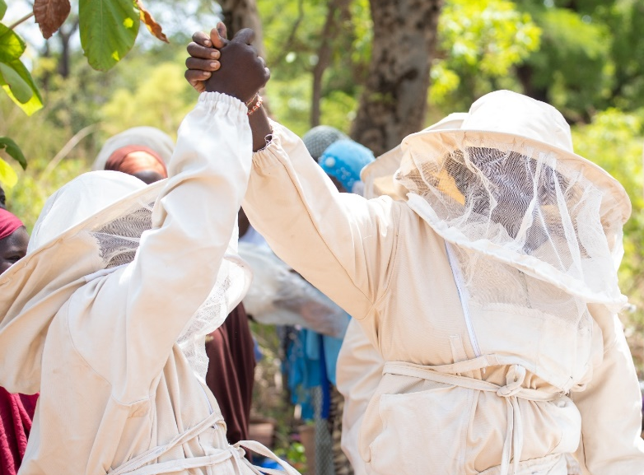
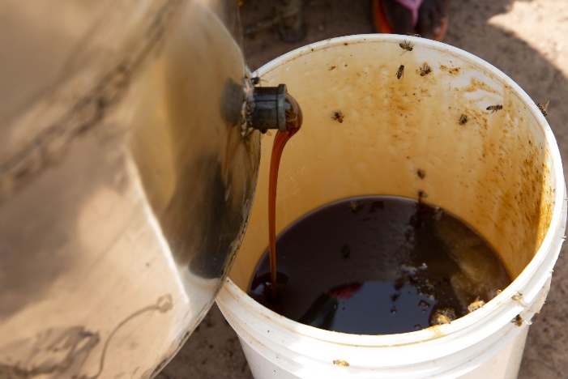
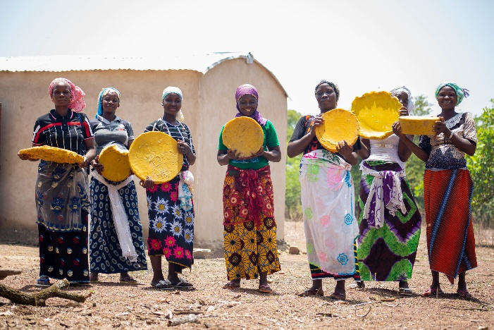
Bees for Business
Impact and Sustainability
2 956 liters of honey produced
Sales of 5 494 000 XOF (7 494.7 £)
Connected to 04 markets(Centre apicole bobo, TON, retailers,
123 Kg of wax for sale of 309 600 XOF
( 407 £)
Only for the year 2023

Slide 7
SHEA AGRO-PROCESSING

Slide 8
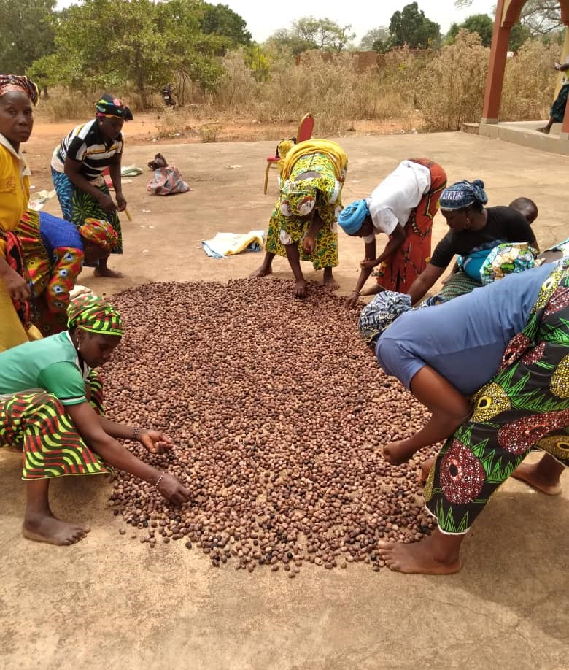
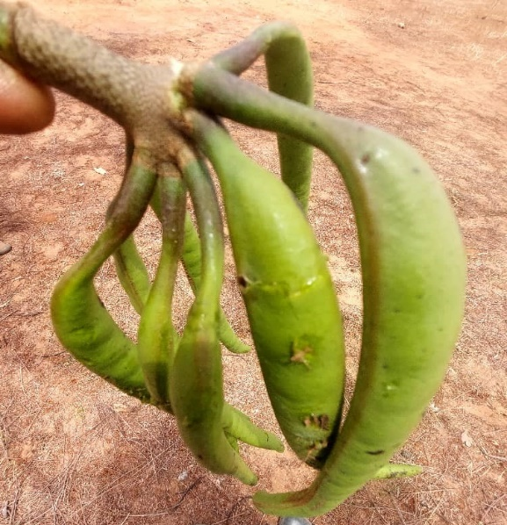
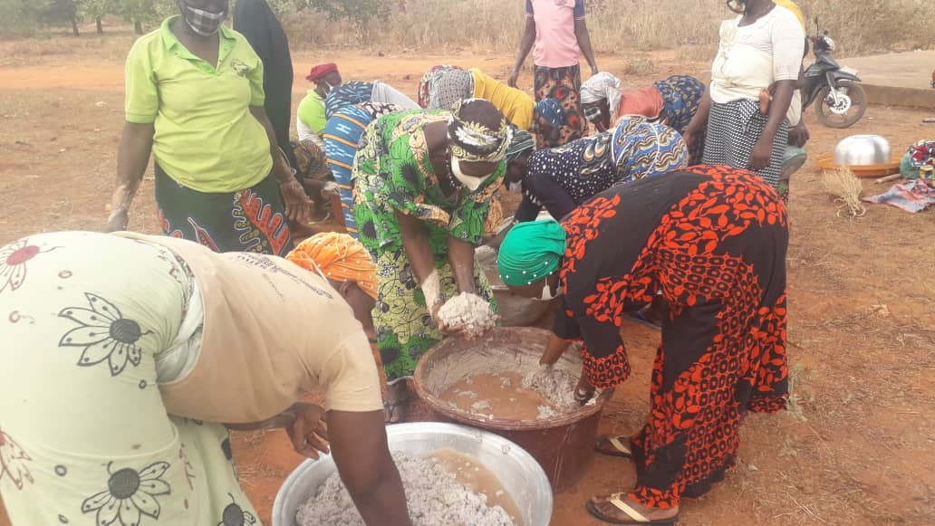
Shea agro-processing
Distribution of production kits for soap, butter and soumbala spice
Practical training in shea processing and soumbala production
Training in Agri-business and rural entrepreneurship

Slide 9
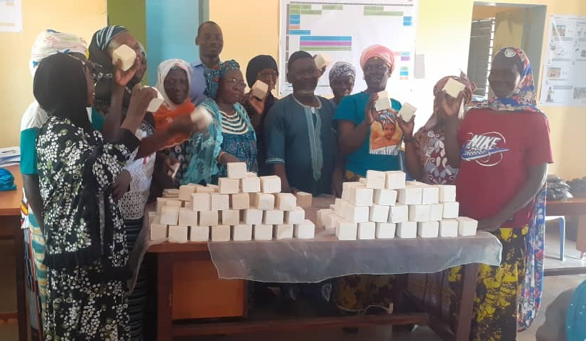

Slide 10
SOILLESS FARMING

Slide 11
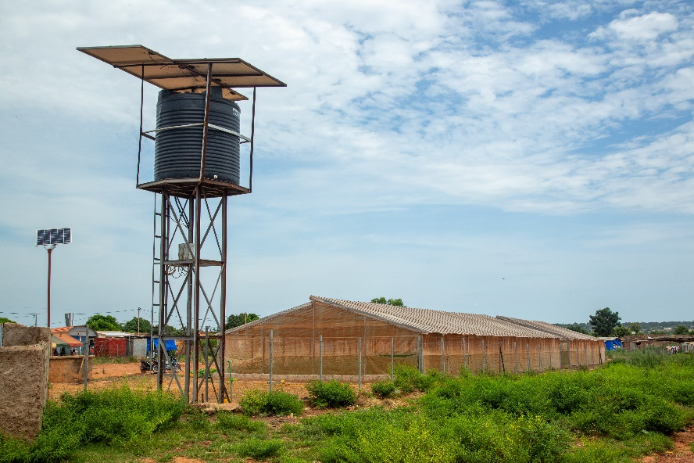
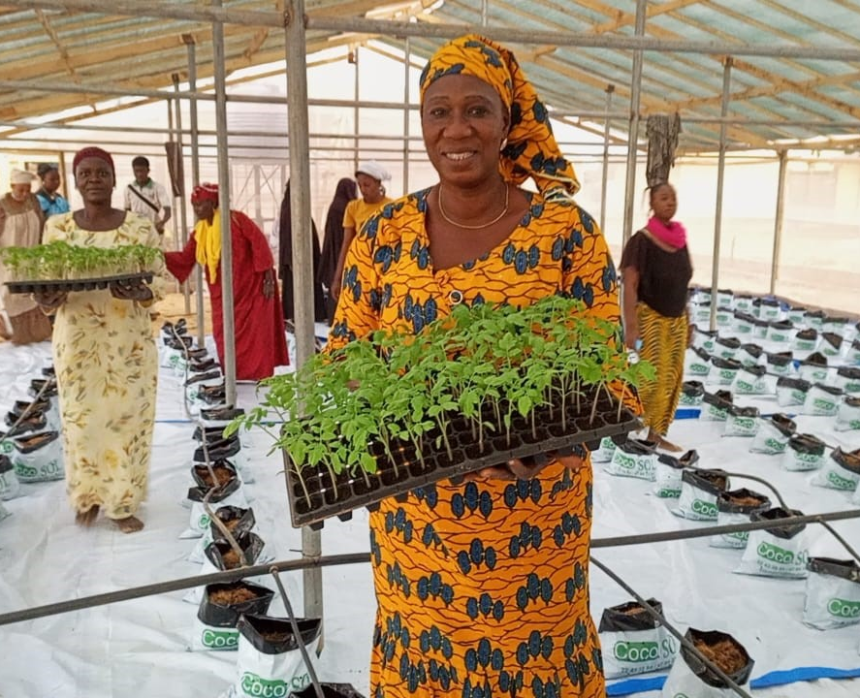
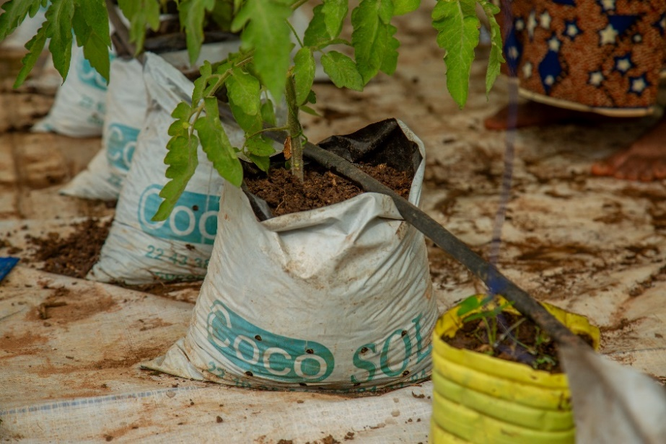
Improving livelihoods through soilless farming (2022 – 2023)

Slide 12
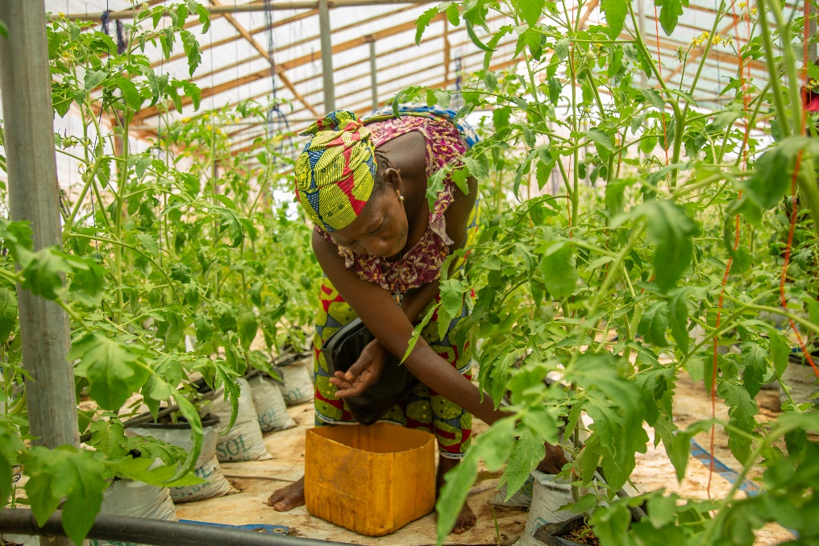
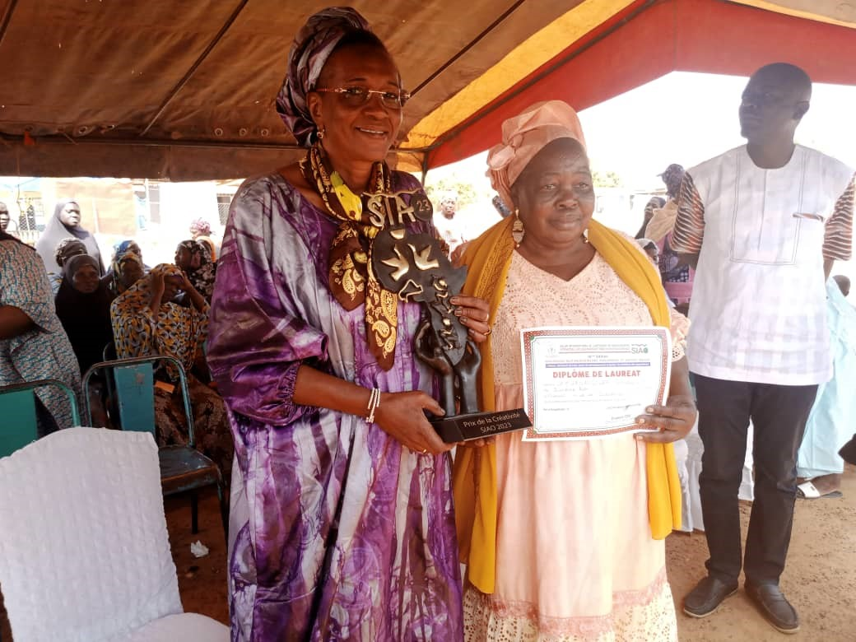
Improving livelihoods through soilless farming
Production of assorted organic vegetables
Fev 11th 2023Visit from Minister for Solidarity and Humanitarian Action and partnership with Institute of Rural Development at Nazi Boni University

Slide 13
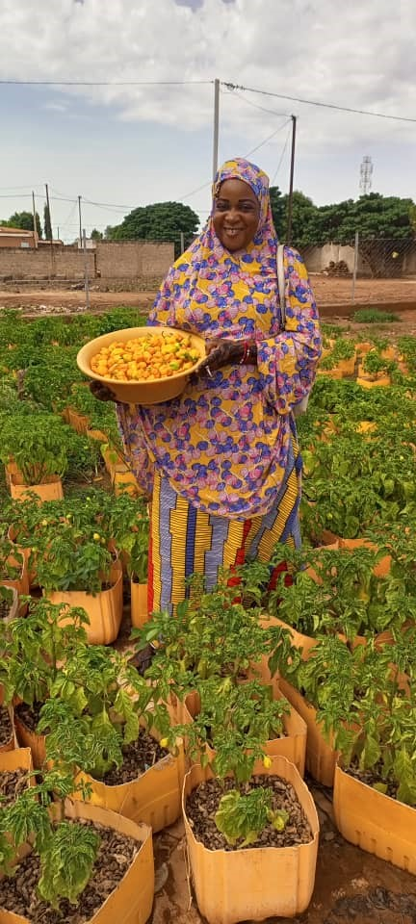
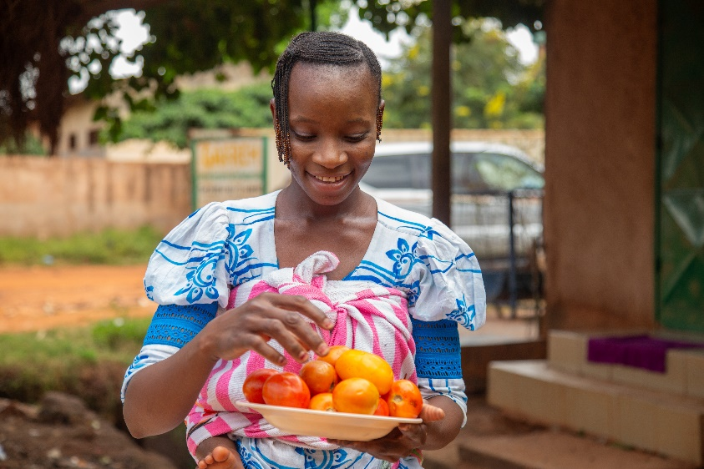
Project impact and sustainability
Total production volume 16 111 Kg
Sales 6 302 500 XOF ( 5 661 £)
Vegetables :cucumbers, tomatoes and chilli peppers
Customers Restaurant Dankan, Mande, University of bobo, local traders

Slide 14
Summary of impact
SOCIAL
More solidarity between women, a beekeeping activity that was once reserved for men, is no longer so. Women are more valued in the family and community because they have an income generating activity
Availability of quality products closer to home. These sites like the soilless farming greenhouses are now places of school and learning
ECONOMIC
Projects provide income to women. They contribute to the family's expenses and are no longer entirely dependent on the husband
ENVIRONMENTAL
Because of the production of honey, shea butter and Soumbala, the trees are protected and this contributes to the mitigation of the effects of climate change.

